Slide 1


Exploring Digital Solutions for Climate Change
Group member
Bishal lamichhane-NP069450
Arjun Basnet-NP069444
Kritagya shahi-NP069462
Aayush Bhandhari-NP069436
Bijaya Neupana-NP069448

Slide 2
Introduction
Climate change is a critical global challenge.
Human activities contribute to greenhouse gas emissions and climate disruptions.
Digital technology's potential in mitigating climate change needs exploration.

Slide 3
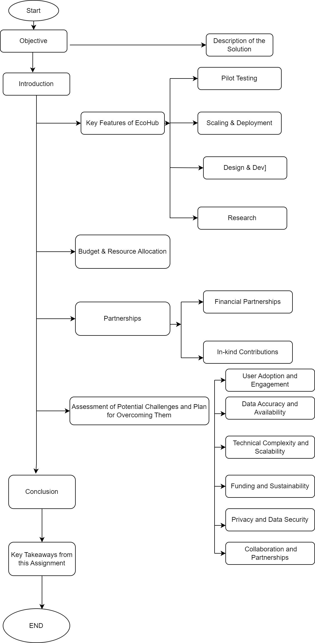
Flow chart

Slide 4

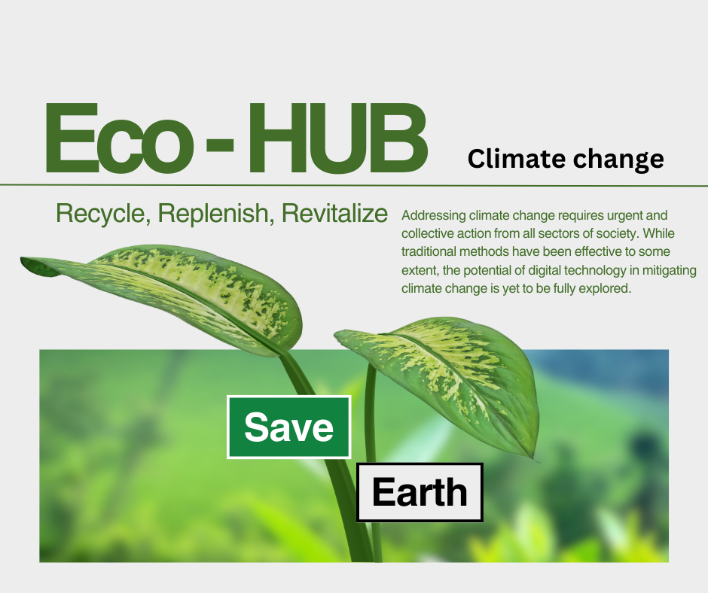
EcoHub Solution
"EcoHub": A digital platform to address climate change.
Centralized hub for individuals, businesses, and communities.
Tools and resources for reducing carbon footprint and promoting sustainability.

Slide 5
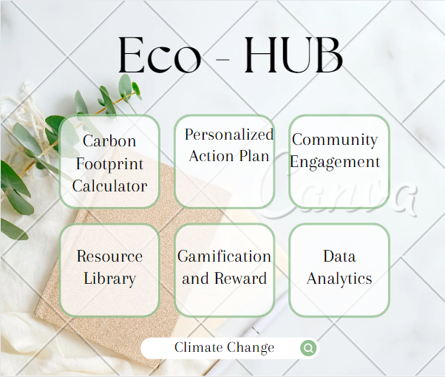
Key Features of EcoHub
Carbon Footprint Calculator: Measure emissions from energy, transportation, etc.
Personalized Action Plans: Tailored steps to reduce carbon footprint.
Community Engagement: Connect, share, and collaborate on sustainability.
Resource Library: Access educational materials, research, and innovative solutions.
Gamification and Rewards: Incentives for sustainable behaviors.
Data Analytics: Insights into environmental impact and progress.

Slide 6
Implementation Plan
Research and Analysis: Understand user needs and partnerships.
Design and Development: User-friendly interface, backend infrastructure.
Pilot Testing and Feedback: Refine based on user input.
Scaling and Deployment: Marketing, partnerships, infrastructure scaling.
Maintenance and Updates: Regular maintenance, security, data backups.
Evaluation and Impact Assessment: Measure effectiveness and user engagement.

Slide 7
Challenges & Solutions
User Adoption: Engagement strategies, user feedback, improvements.
Data Accuracy: Collaboration with reliable data providers, validation.
Technical Complexity: Skilled developers, testing, scalability planning.
Funding & Sustainability: Diverse funding sources, transparency.
Privacy & Security: Data protection measures, compliance.
Collaboration: Clear goals, communication, regular coordination.

Slide 8
Conclusion & Takeaways
Digital technology's potential in climate change solutions.
User engagement, collaboration, and continuous improvement are crucial.
Partnerships amplify impact and resources.
Adaptation to feedback and changing circumstances is essential.
Embrace innovation for a sustainable and resilient future.

Slide 9


